Slide 1
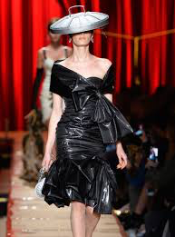
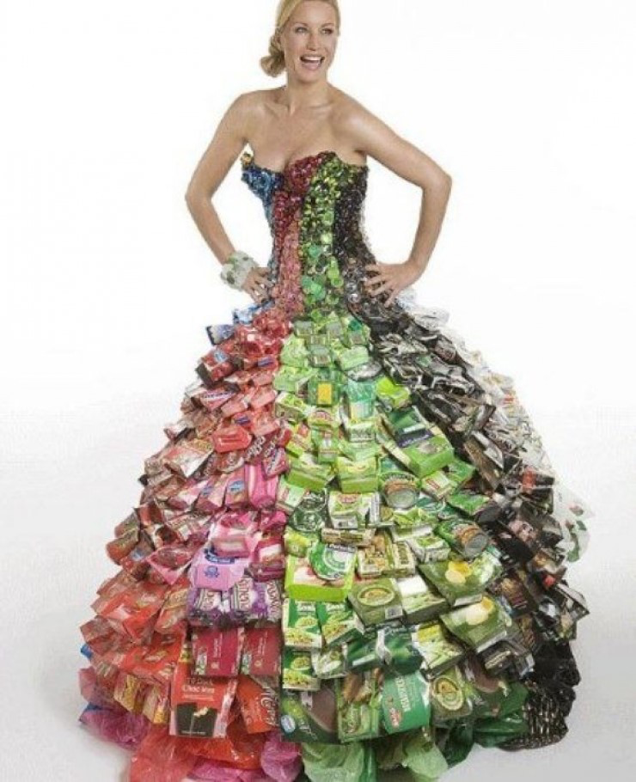
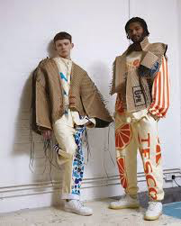
Trashion Fashion
Fillmore Arts Center
Visual Arts Distance Learning
Ms Tsou
Creating Fashion With Recycled Materials

Slide 2
Fillmore Arts Center
Visual Arts Distance Learning
Ms Tsou
I hope you are doing well, keeping yourself safe and having some fun at the same time!
I miss you a lot! If anyone wants to talk on the phone, please ask your parent’s permission. If so, please email me at sally.yick@k12.dc.gov with your phone number and email address and I will try to contact you.

Slide 3
May is a month to celebrate many events. One of them is Asian Pacific Islander Heritage Month
Fillmore Arts Center
Visual Arts Distance Learning
Ms Tsou
I am inspired to create Trashion Fashion (using recycled materials) with an Asian influence

Slide 4
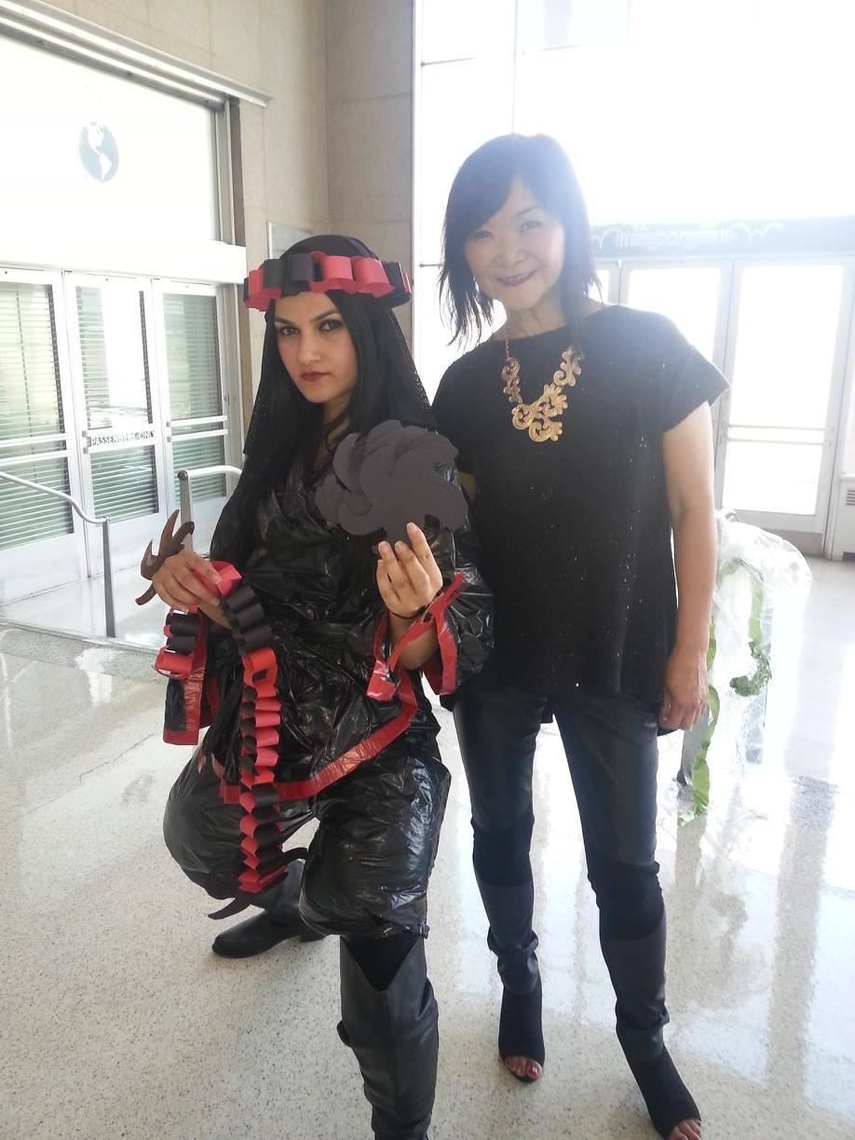
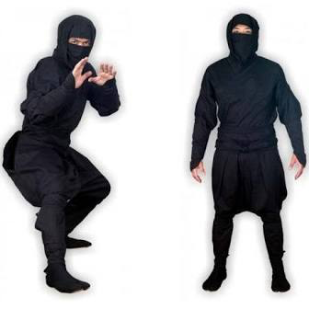
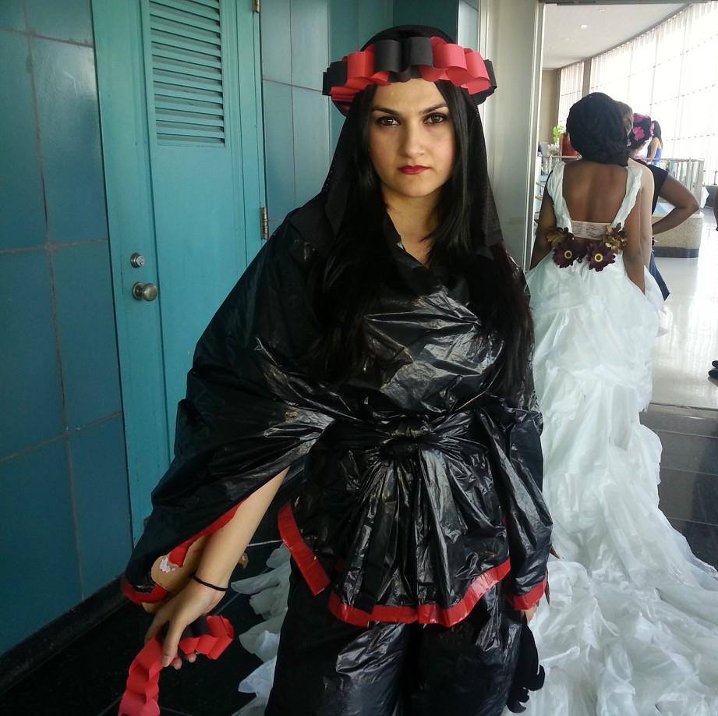
Check out this outfit inspired by ninjas (who are from Asia) and created with garbage bags!
Fillmore Arts Center
Visual Arts Distance Learning
Ms Tsou

Slide 5
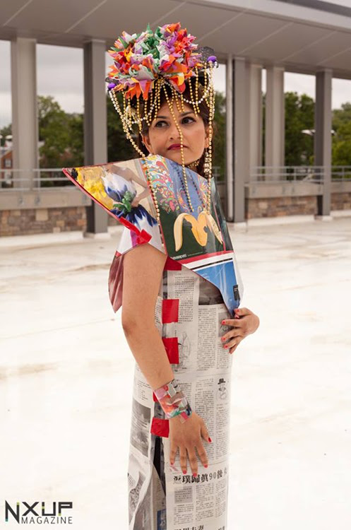
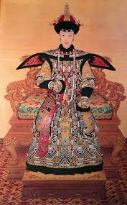
Do you see the connection between this trashion fashion outfit and the emperor’s clothes?
Fillmore Arts Center
Visual Arts Distance Learning
Ms Tsou

Slide 6
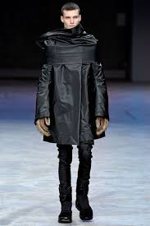
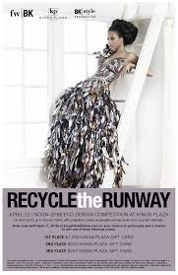
More Trashion Fashion Outfits
Fillmore Arts Center
Visual Arts Distance Learning
Ms Tsou
What are these different outfits made from?

Slide 7
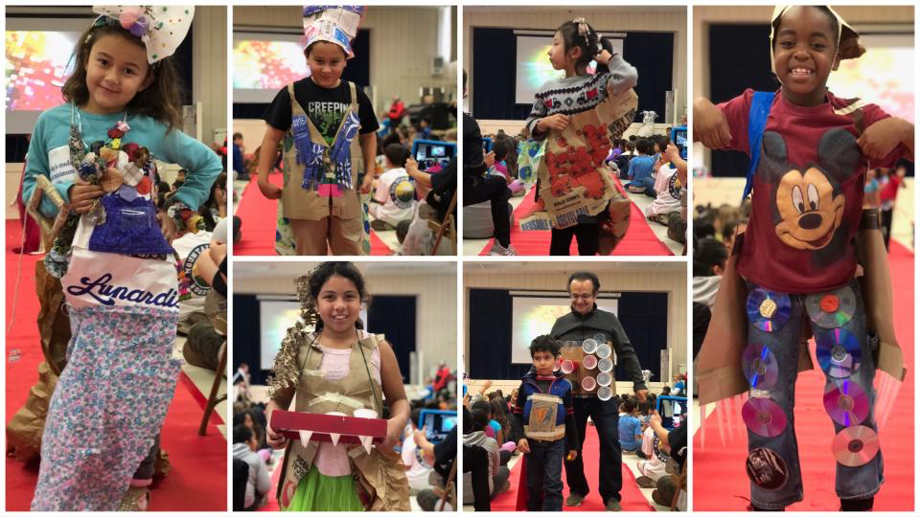
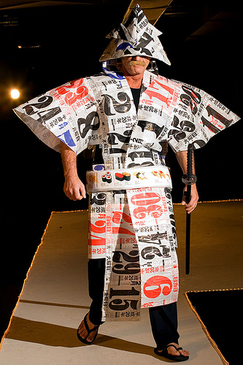
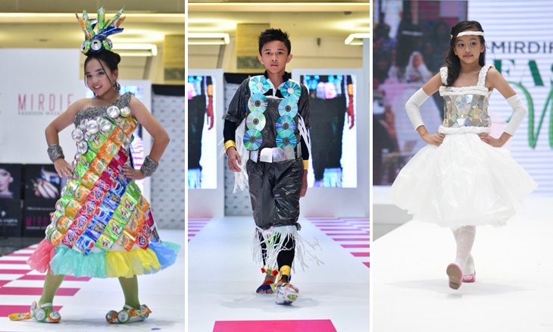
Fillmore Arts Center
Visual Arts Distance Learning
Ms Tsou

Slide 8
Objective: Students will design a functional Trash Fashion Outfit with Asian or other cultural inspiration
Fillmore Arts Center
Visual Arts Distance Learning
Ms Tsou
Use at least 3 of the Elements and Principles of Art to help you create your outfit.
The Elements of Art:
Color, Line, Shape, Texture (the way the art feels or looks like it would feel)
The Principles of Art are the guidelines that govern the way artists organize (arrange) the elements of art.
1. CONTRAST: The arrangement of opposite elements (light vs. dark colors, rough vs. smooth textures, large vs. small shapes, etc.) in a piece so as to create visual interest, excitement and drama.

Slide 9
Principles of Art
Fillmore Arts Center
Visual Arts Distance Learning
Ms Tsou
4. VARIETY: The principle of art that adds interest to an artwork. Variety works through juxtaposition and contrast. When an artist places different visual elements next to one another, he/she is using variety. ... Principles of art bleed into one another. They overlap.
5. OVERLAP: Overlapping in art is the placement of objects over one another in order to create the illusion of depth. Painting is a two-dimensional artistic expression. It has length and width but no depth.
1. CONTRAST: The arrangement of opposite elements (light vs. dark colors, rough vs. smooth textures, large vs. small shapes, etc.) in a piece so as to create visual interest, excitement and drama.
2. EMPHASIS: An area or object within the artwork that draws attention and becomes a focal point. Subordination is defined as minimizing or toning down other compositional elements in order to bring attention to the focal point. It is the largest object in the composition.
3. REPETITION: The recurrence of a particular line, pattern, shape, or other visual elements in a single or part of the series. The production of something repetitive yet exciting is a challenge, as many consider the recurrence as boring and still.

Slide 10
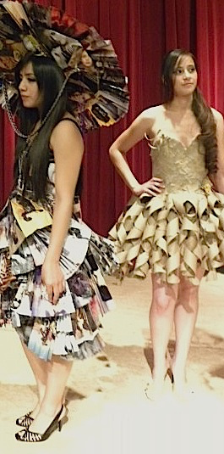
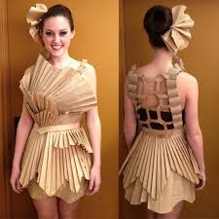
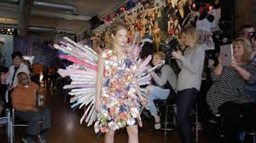
What elements and principles of art do you see in these designs?
Fillmore Arts Center
Visual Arts Distance Learning
Ms Tsou

Slide 11
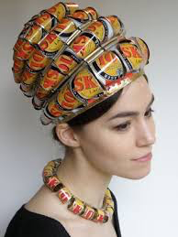
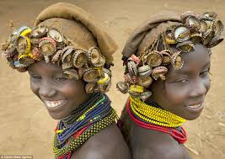
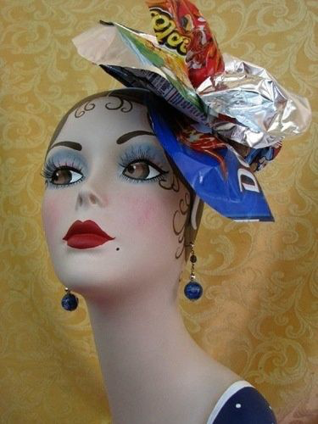
What elements and principles of art stand out when you look at these works?
Fillmore Arts Center
Visual Arts Distance Learning
Ms Tsou

Slide 12
Trashion Fashion Design Steps:
Fillmore Arts Center
Visual Arts Distance Learning
Ms Tsou
Sketch your design. It can be a hat, mask, glove or whole outfit
Collect the recycling objects that you will use
Using the elements and principles of art as your guide, and continue to refine your idea.
Assemble your outfit, using glue, staples, tape, needle and thread or any means to assemble the outfit
Check that you can wear the item without it falling apart
Now wear it and ‘walk the runway’!
Take a picture of what you created (with someone wearing it if possible)

Slide 13
Materials:
Fillmore Arts Center
Visual Arts Distance Learning
Ms Tsou
Recycled material, fabric, box, newspaper, ribbon, beads, strings, papers, feathers, paper cups and bowls, beads, balloons, or other
Tape
Glue
Cutting tools
Paper clips
Staples
Any additional materials and tools you may need

Slide 14
Questions:
When you finish:
Fillmore Arts Center
Visual Arts Distance Learning
Ms Tsou
Please name at least 3 elements and principles of art you used in your design.
Describe how you used the art principles & elements to make your art more interesting.
Can you expand your design more to make it super interesting? Where and how?
What is the most difficult part of this project and how did you find a solution?
Take pictures of your outfit AND your written answers and email to: sally.yick@k12.dc.gov

